Slide 1
WELCOME TO THE PRESENTATION of
CSE 103

Slide 2
COURSE CO-ORDINATOR : MD. ASIF HOSSAIN GROUP MEMBERS : AKEED ANJUM-13101097 SAFWAN TOWSHIK-13101098 TOFA MOLY-13101101

Slide 3



TOPIC : STUDENT MANAGEMENT

Slide 4
Points :
Introduction
Basic
Application of Project
Data screen
project screen
In future
Conclusion

Slide 5
Student Management
Student management is about managing student information. It’s a software that stores information about students in a School, College and University. There are different types of student management system based on the requirement of the institution.

Slide 6
Basic
The basic function of a student management system is to store –
Student ID
Student name
Student gender
Student address
Student term
Department
Blood group

Slide 7
Application of Project
We made our project based on basic information, where students information are stored according to their ID. Typing an ID will show the specific student information such as student name, address, gender, department, blood group etc.

Slide 8
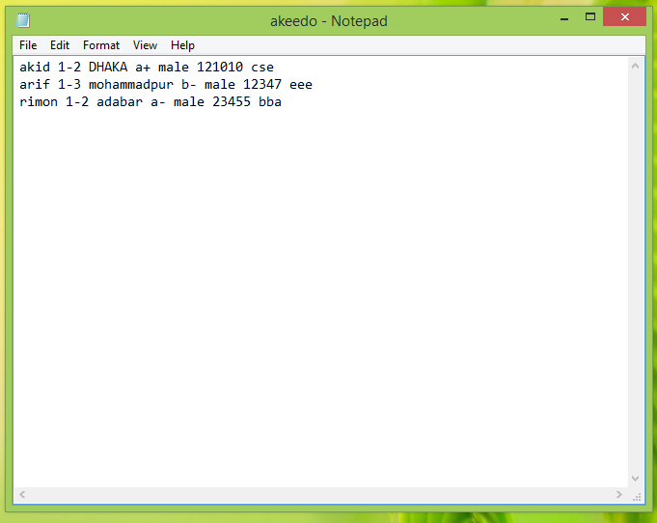
Data screen

Slide 9
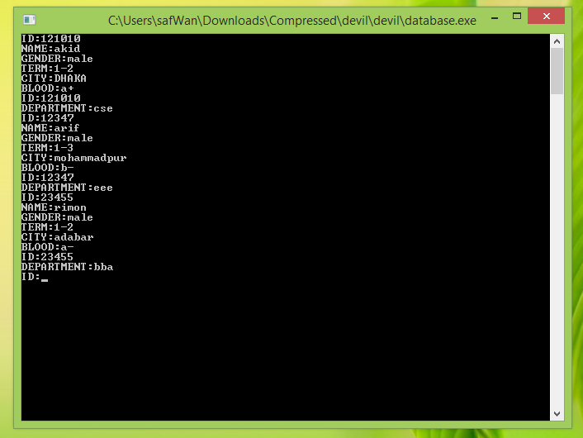
Project screen

Slide 10

In future
Still we have lot to do….
Academic progress
Weak student education plan
Exams, assignments datasheet
Attendance data
Guardian information
Fees management etc.

Slide 11

CONCLUSION
ENGINEER

Slide 12
THANKS TO EVERYONE
-_-_-_-
ANY QUARY
????

